Slide 1
A Paleoseismic study of the Twin Lakes Fault, Mount Hood Fault Zone, Oregon
Charlie Carr
Geology Undergraduate
McNair Scholar
Active Tectonics Lab
Portland State University

Slide 2
Mount Hood
Notes:
~65 miles East of PDX.
Stratovolcano – layers – lava flow, ash, cinders, blocks – steep sided – explosive
Shield volcanoes (eastern Oregon CRB), cinder cones (pumice, scoria)
Last active in Holocene (~12 thousand years since LGM)
Old Maid Eruptive activity (in study area, lahars and flow) ~250 years ago
Timberline Eruptive Period (lahars and flows towards hood river) ~1500 ya
4 OR Cascade volc very high threat. Crater Lake, Hood, Newberry, South Sister.
Despite this, only 12 current monitoring stations (W/in 20mi of summit) on Hood.
Two types of seismicity
Small mag shallow events under summit
More frequent larger eq clusters to the west south and south east

Slide 3
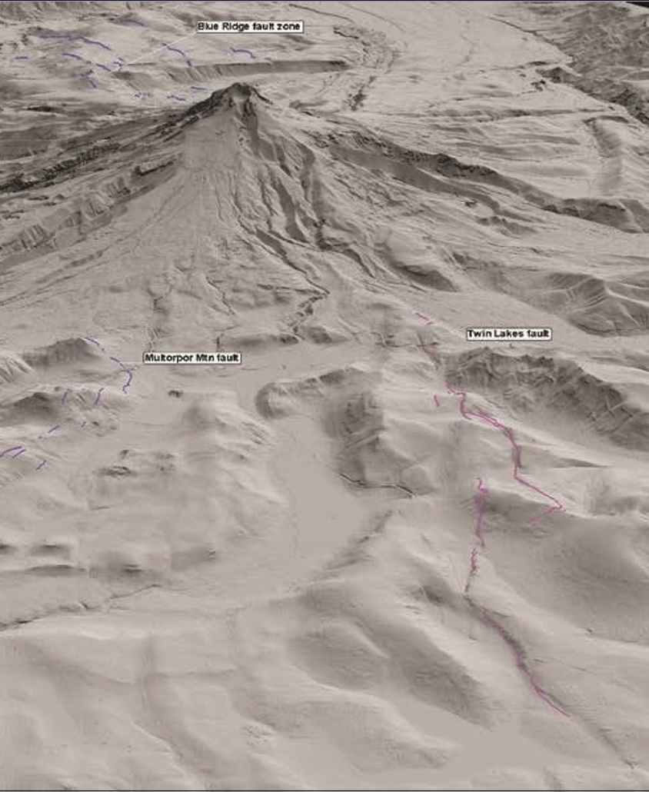
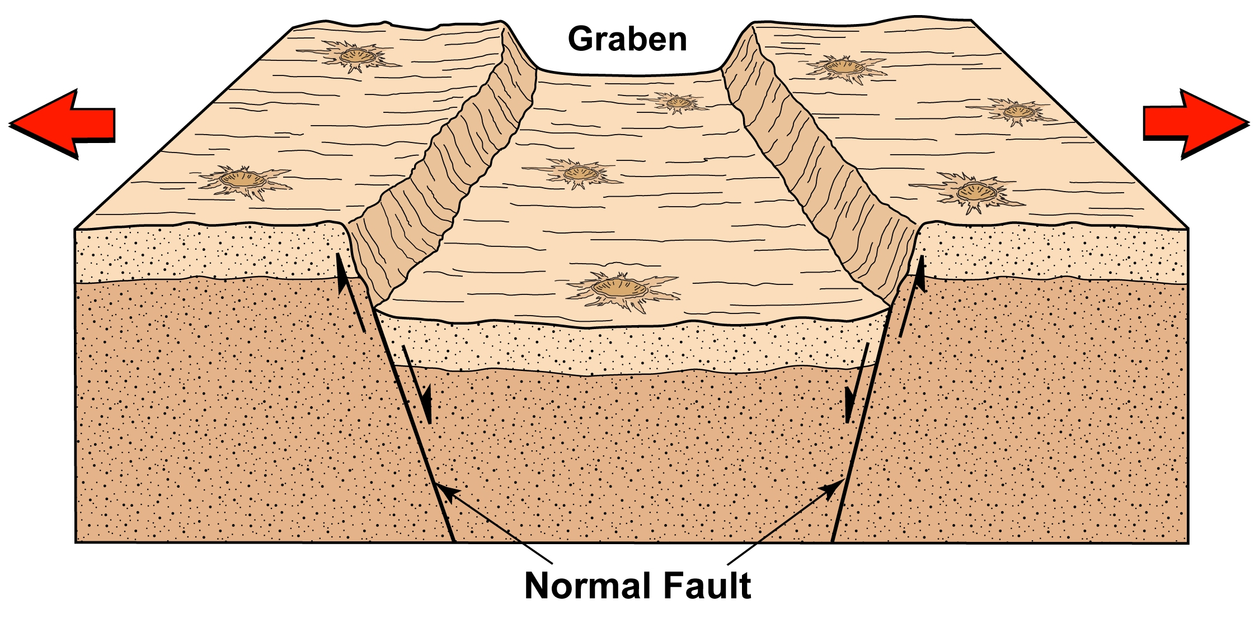
Mount Hood Fault Zone
Step-over
Figures from Madden et al. 2017
Notes:
In 2007 high resolution lidar data obtained by Ian Maddin of Dogami
Lidar is a remote sensing method – pulsed lasers to measure variable distances to earth. Using the lasers, scanners, and gps, can derive precise 3-D info. Last returns get bare earth.
Mapped Mount Hood Fault Zone
Consists of 4 north trending normal faults extending ~55km across the volcanic summit from clear lake to Columbia river.
Gate creek fault
Blue ridge fault zone
Multorpor mountain fault
Twin lakes fault
Twin Lakes fault south of summit and extends ~13km from clear lake to OR35
Graben fomed between multorpor mountain fault and twin lakes fault
Normal fault rx move down, reverse fault rx move up, strike slip
Twin lakes has two west dipping fault strands connected with stepover
Highest occurrence of EQ clusters
Study area is on northern terminus, near white river

Slide 4
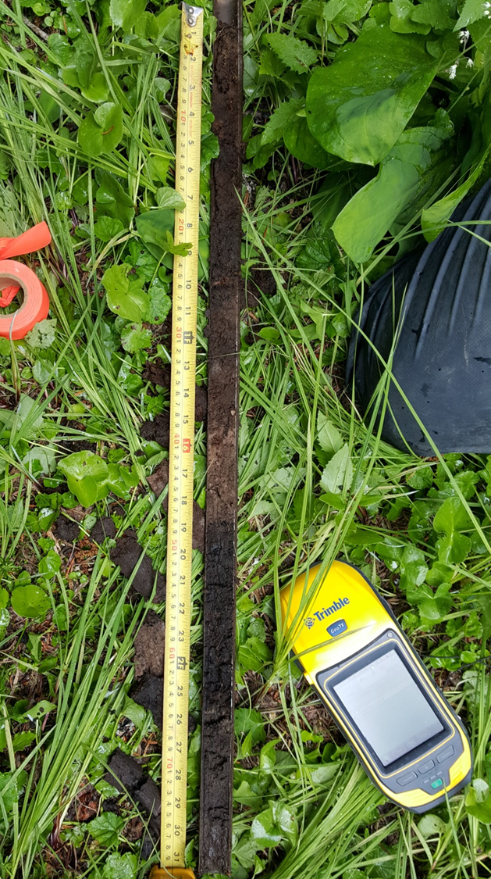
Previous Research
Reconnaissance by Streig and Maddin successfully located an ideal trench site in a small wetland along the White River.
Small drainage was impounded by ~2m of downward motion along the fault.
Best location to find datable organic material and thinly bedded strata
Gouge cores obtained by Streig found buried organic material age dated to 3446 – 3561 BP
Image provided by Dr. Ashley Streig
Notes:
Uphill facing scarp created dam, impounding drainage, water depositing against dam, sediment and organic material accumulation
Gauge core revealed date of organic material 3500 years ago
Looking for datable material above and below faulted units

Slide 5
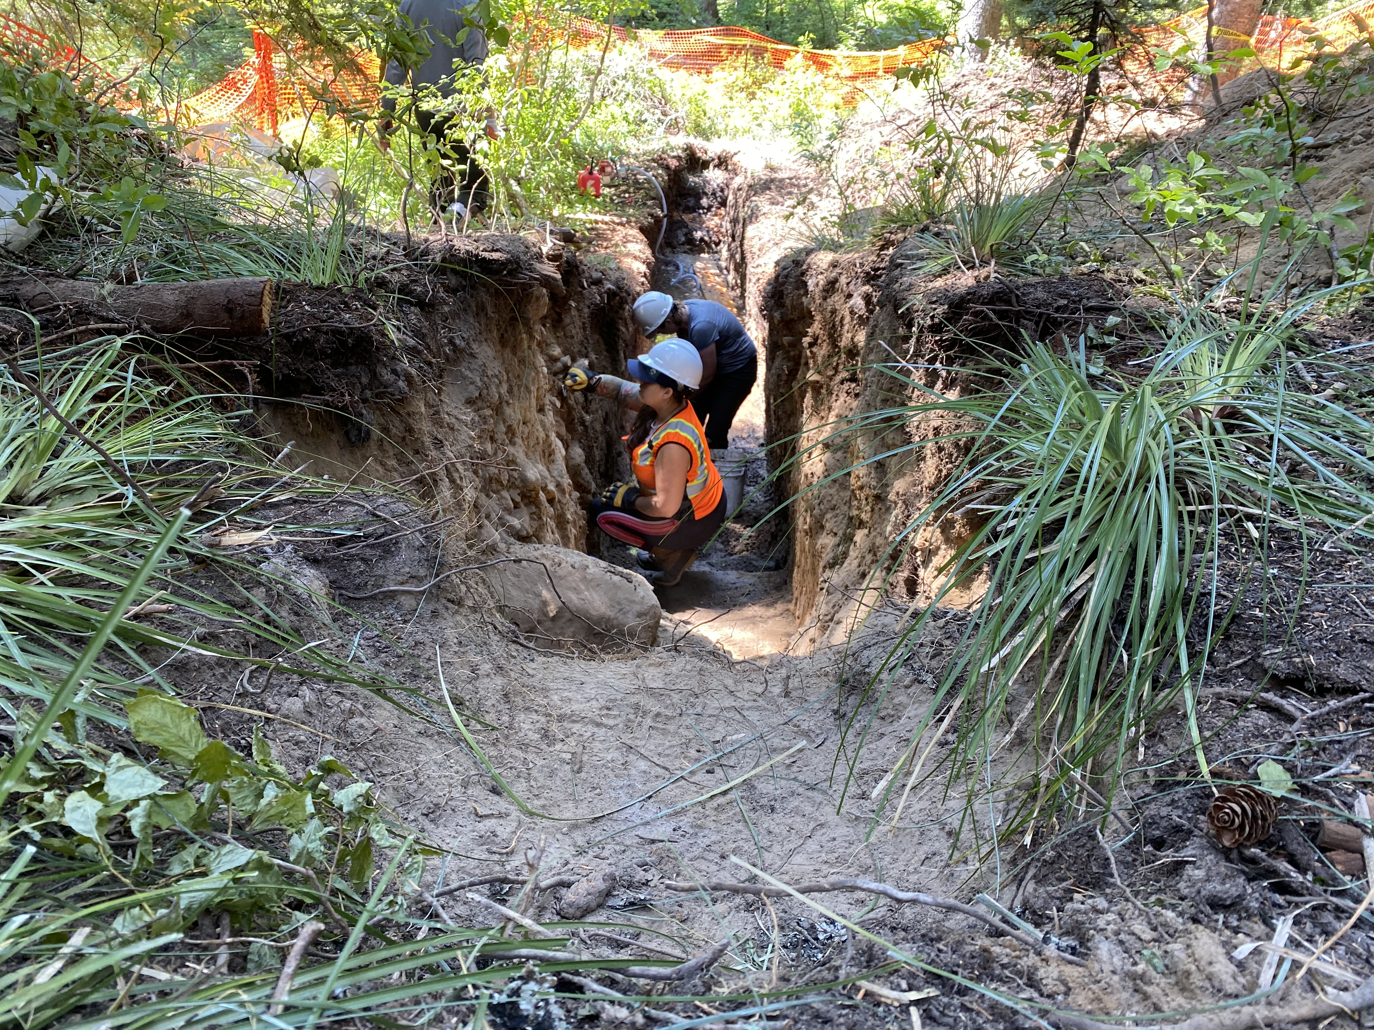
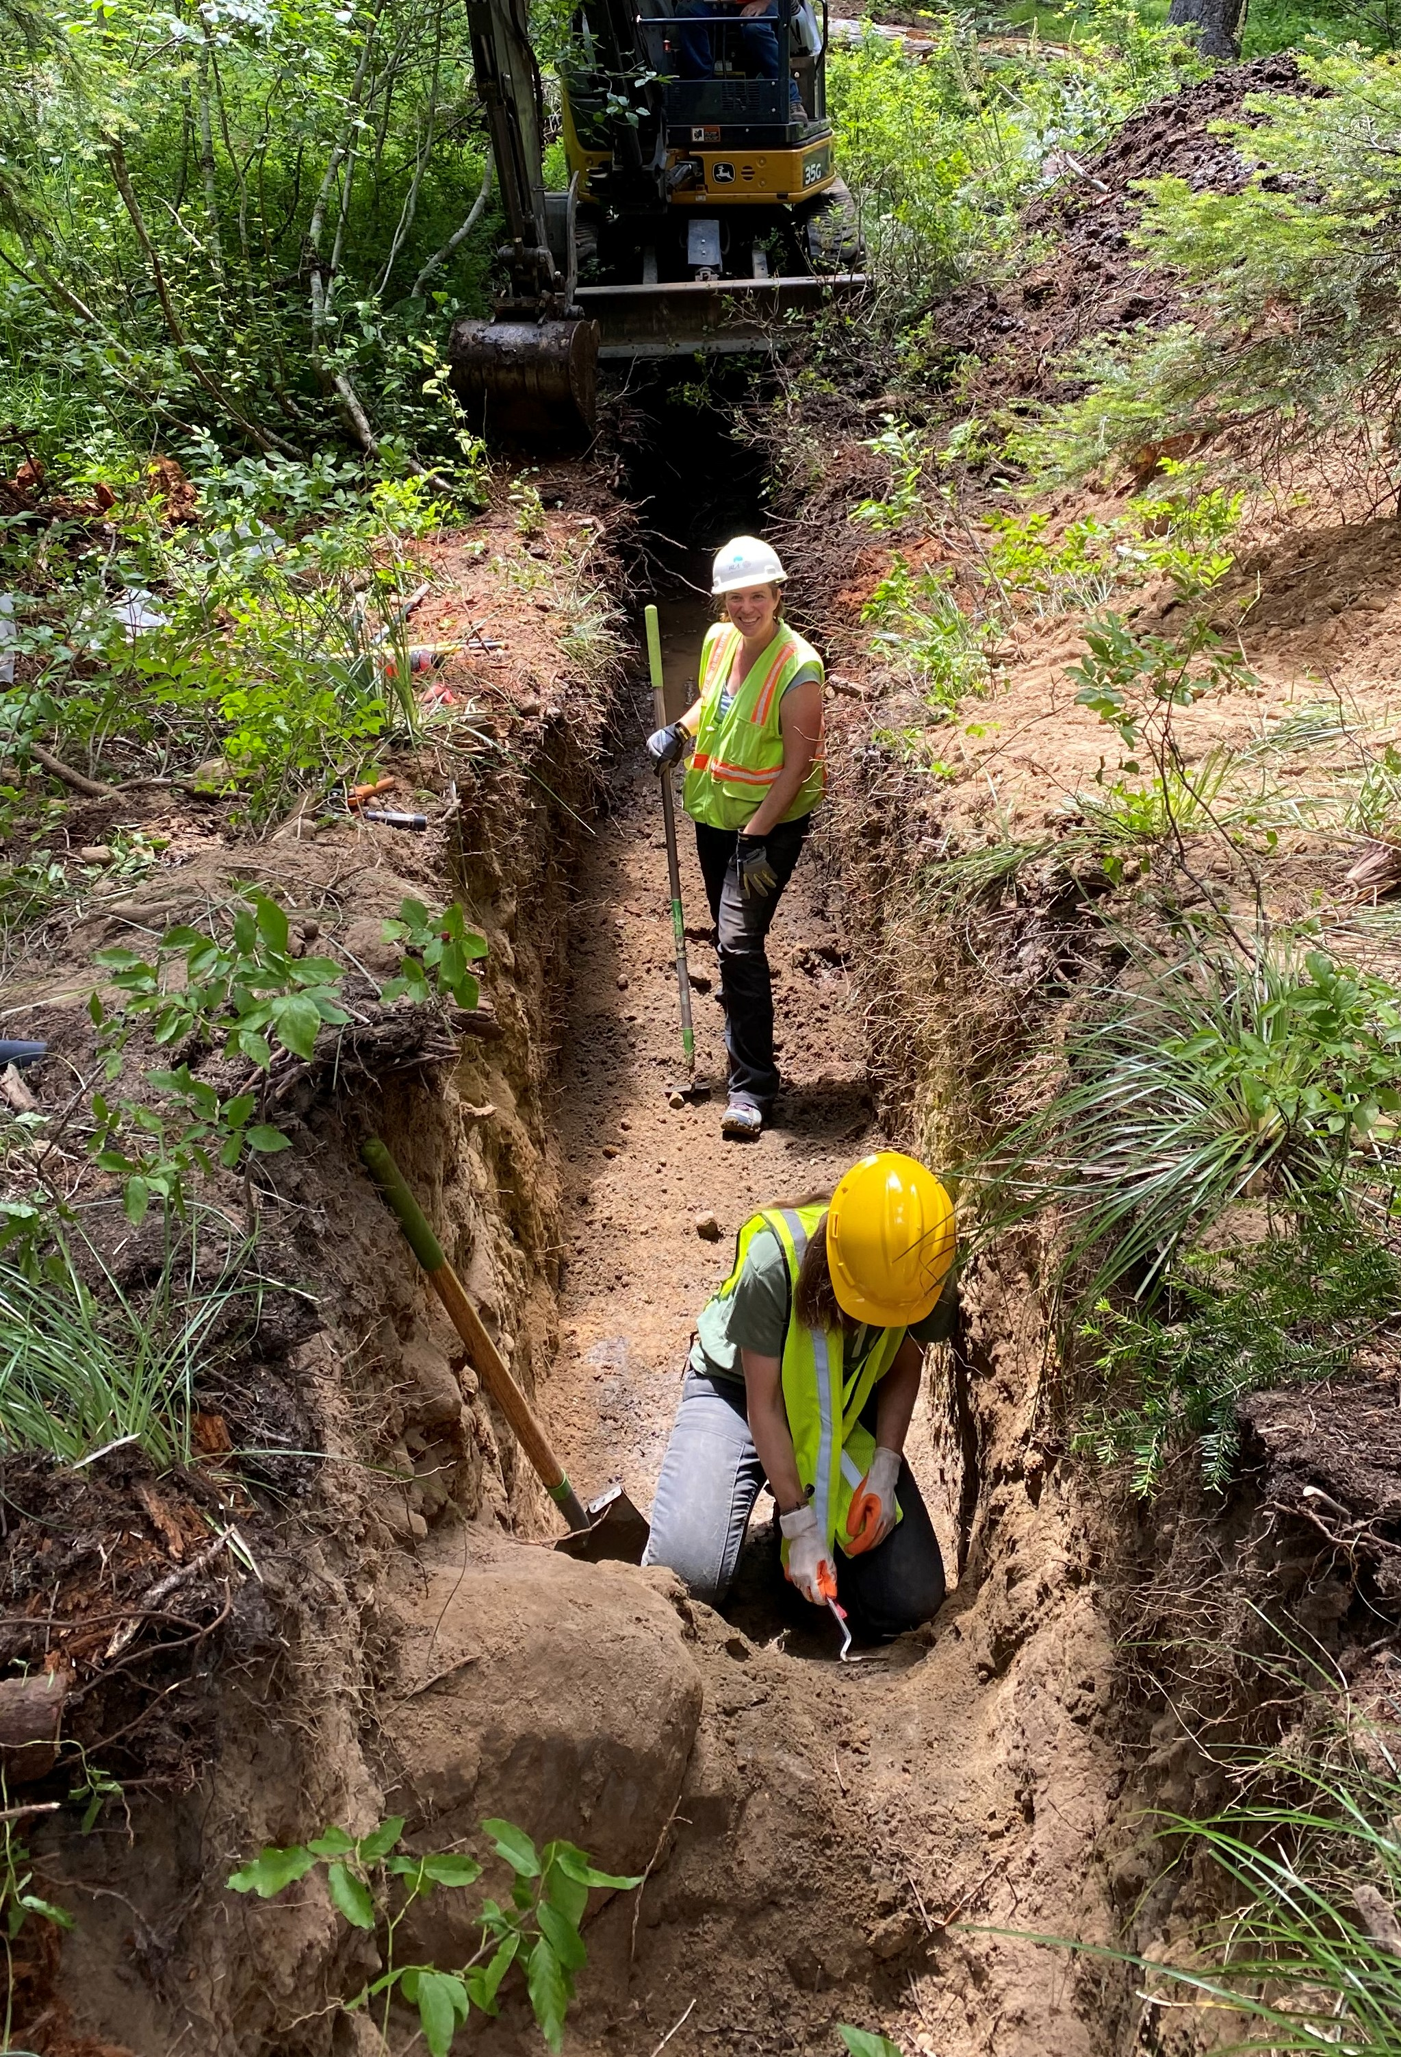
Current Research
Notes:
Site selection just south of previous recon
Dig and prep trench

Slide 6
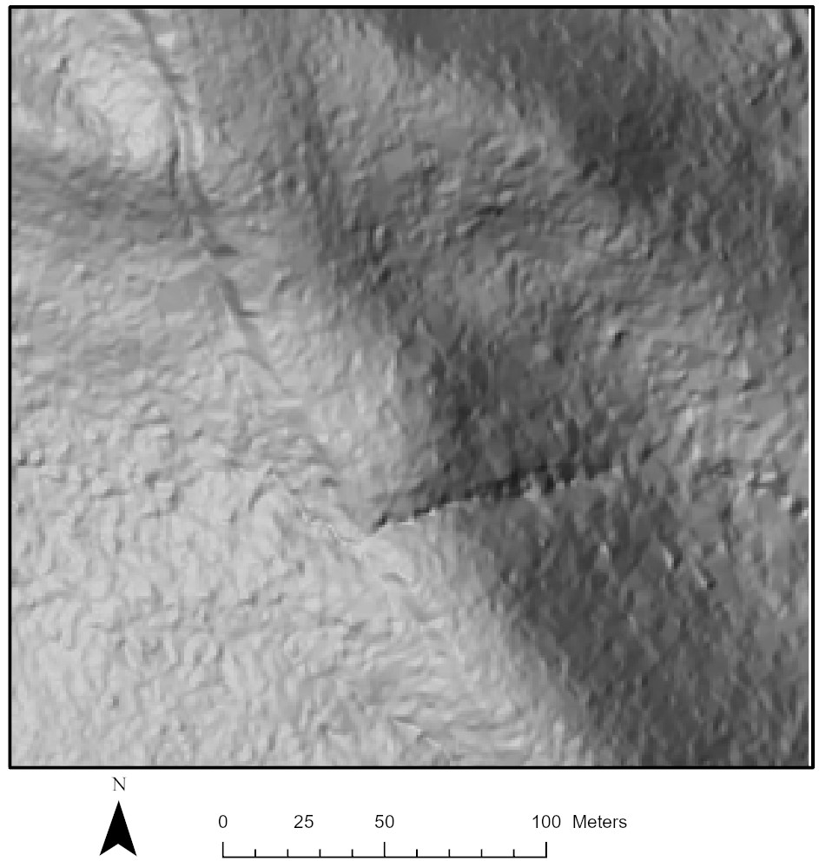
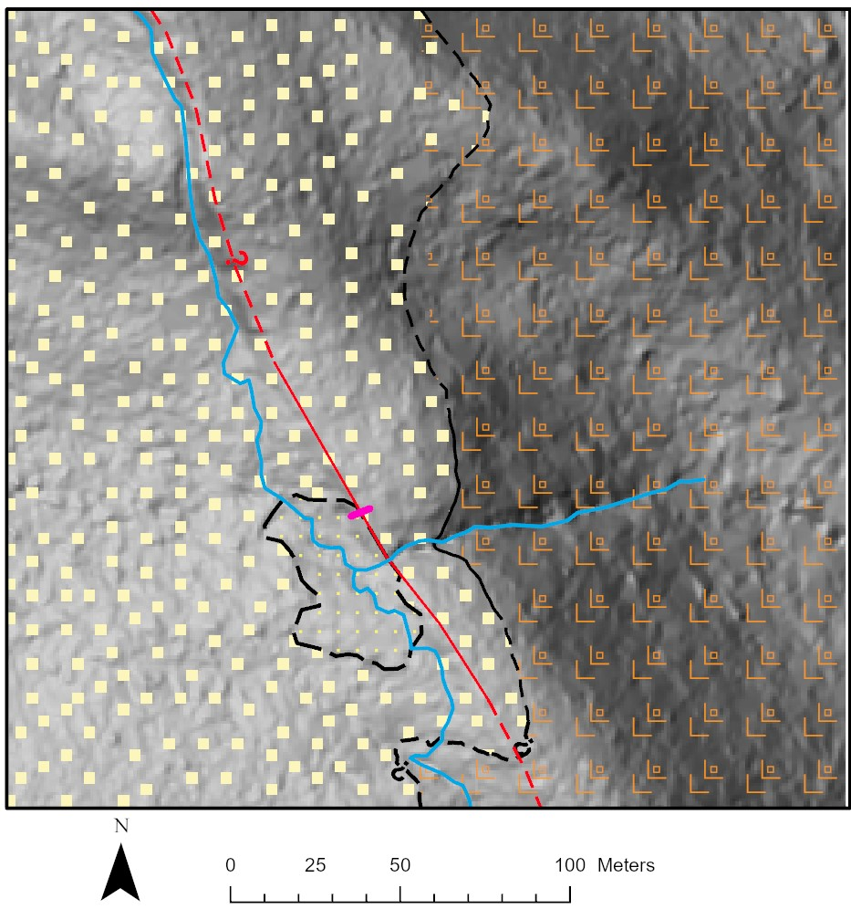
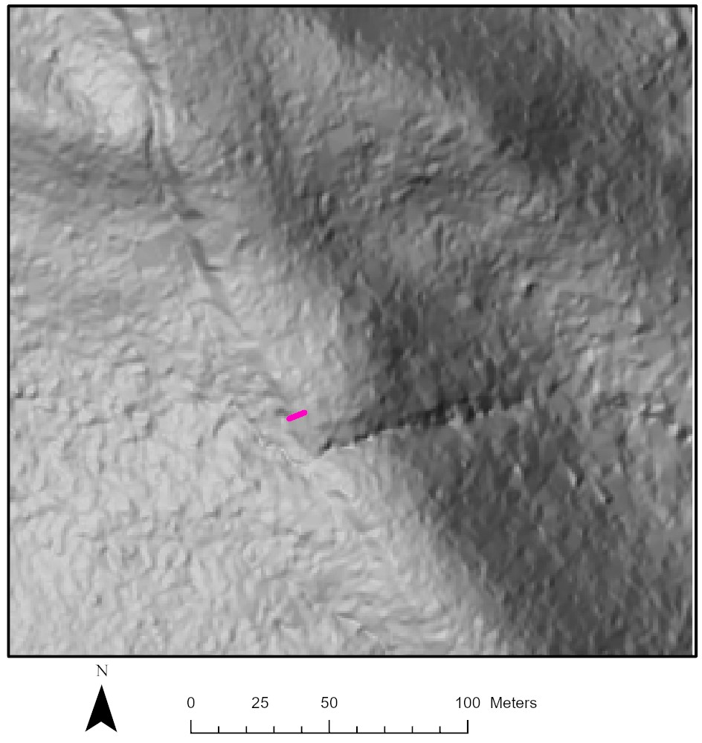
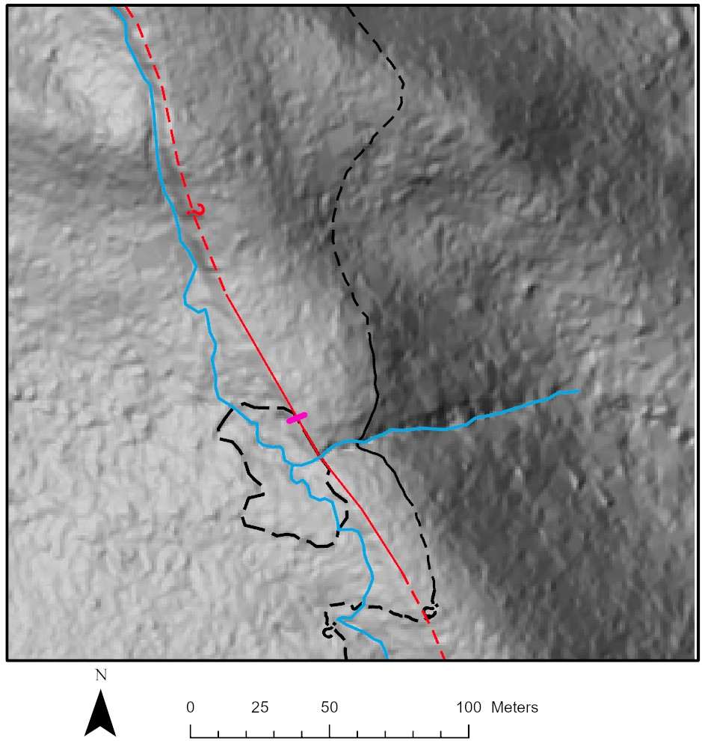
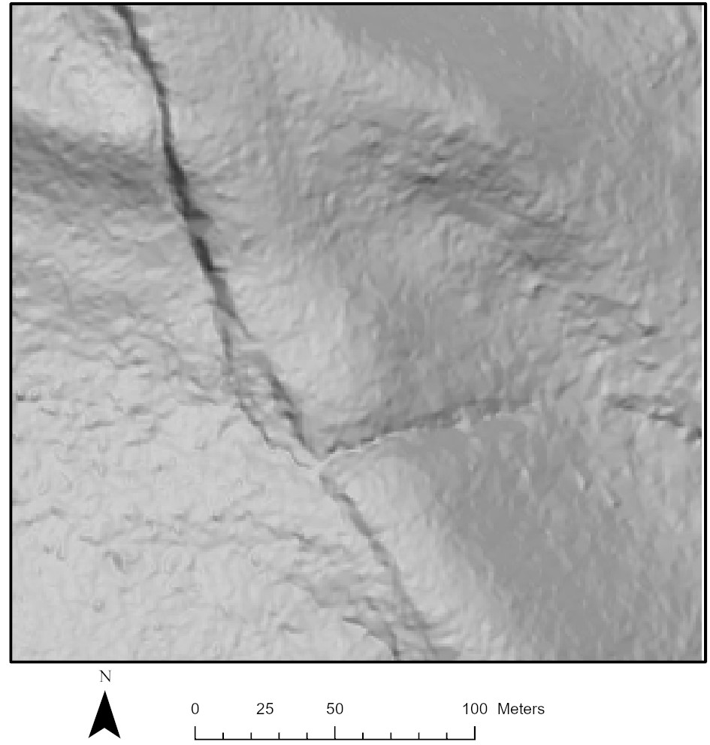
Mapping!
Notes:
left azmuth 315 – NW --- Right azmuth 45 – NE
Trench location – 13m length 50deg north – 20.5 meters from stream along fault
Contacts
Bedrock - Tertiary Rhyolitic Bedrock
Quaternary Glacial Deposits
Holocene Marsh Deposits (12000 years ago LGM)

Slide 7
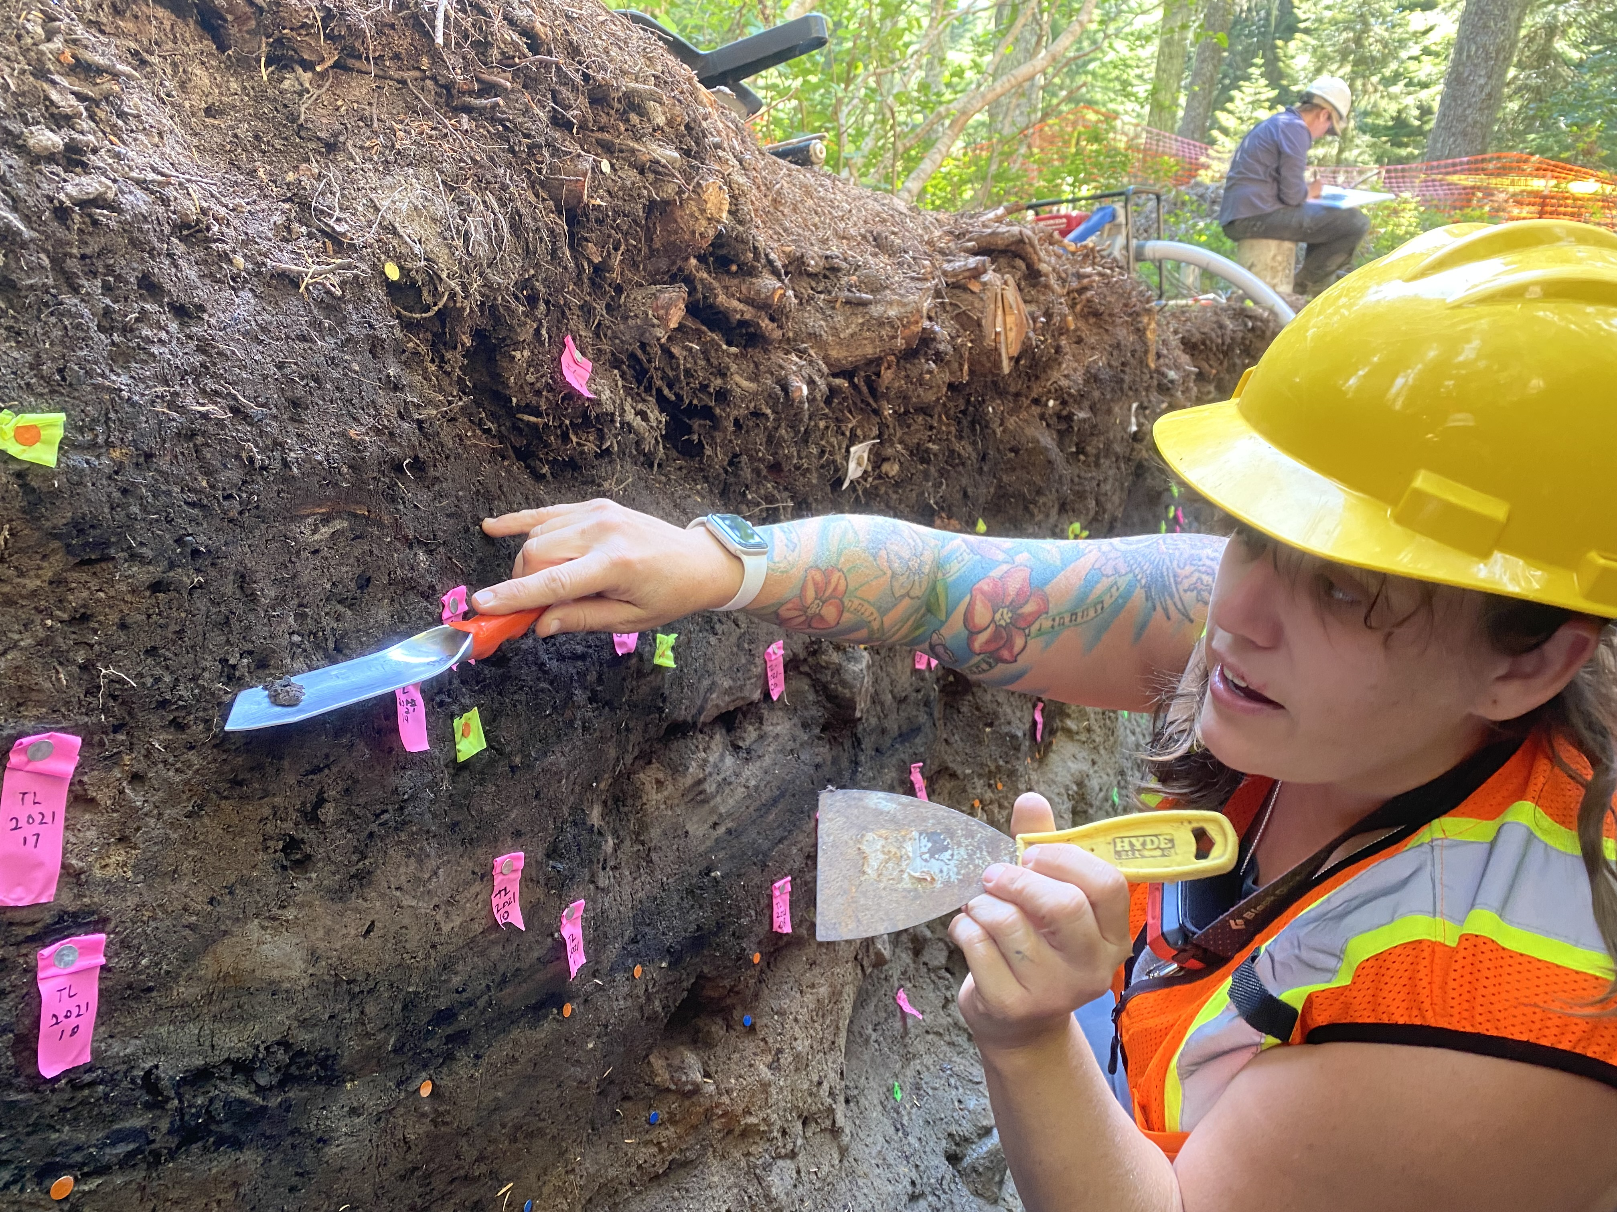
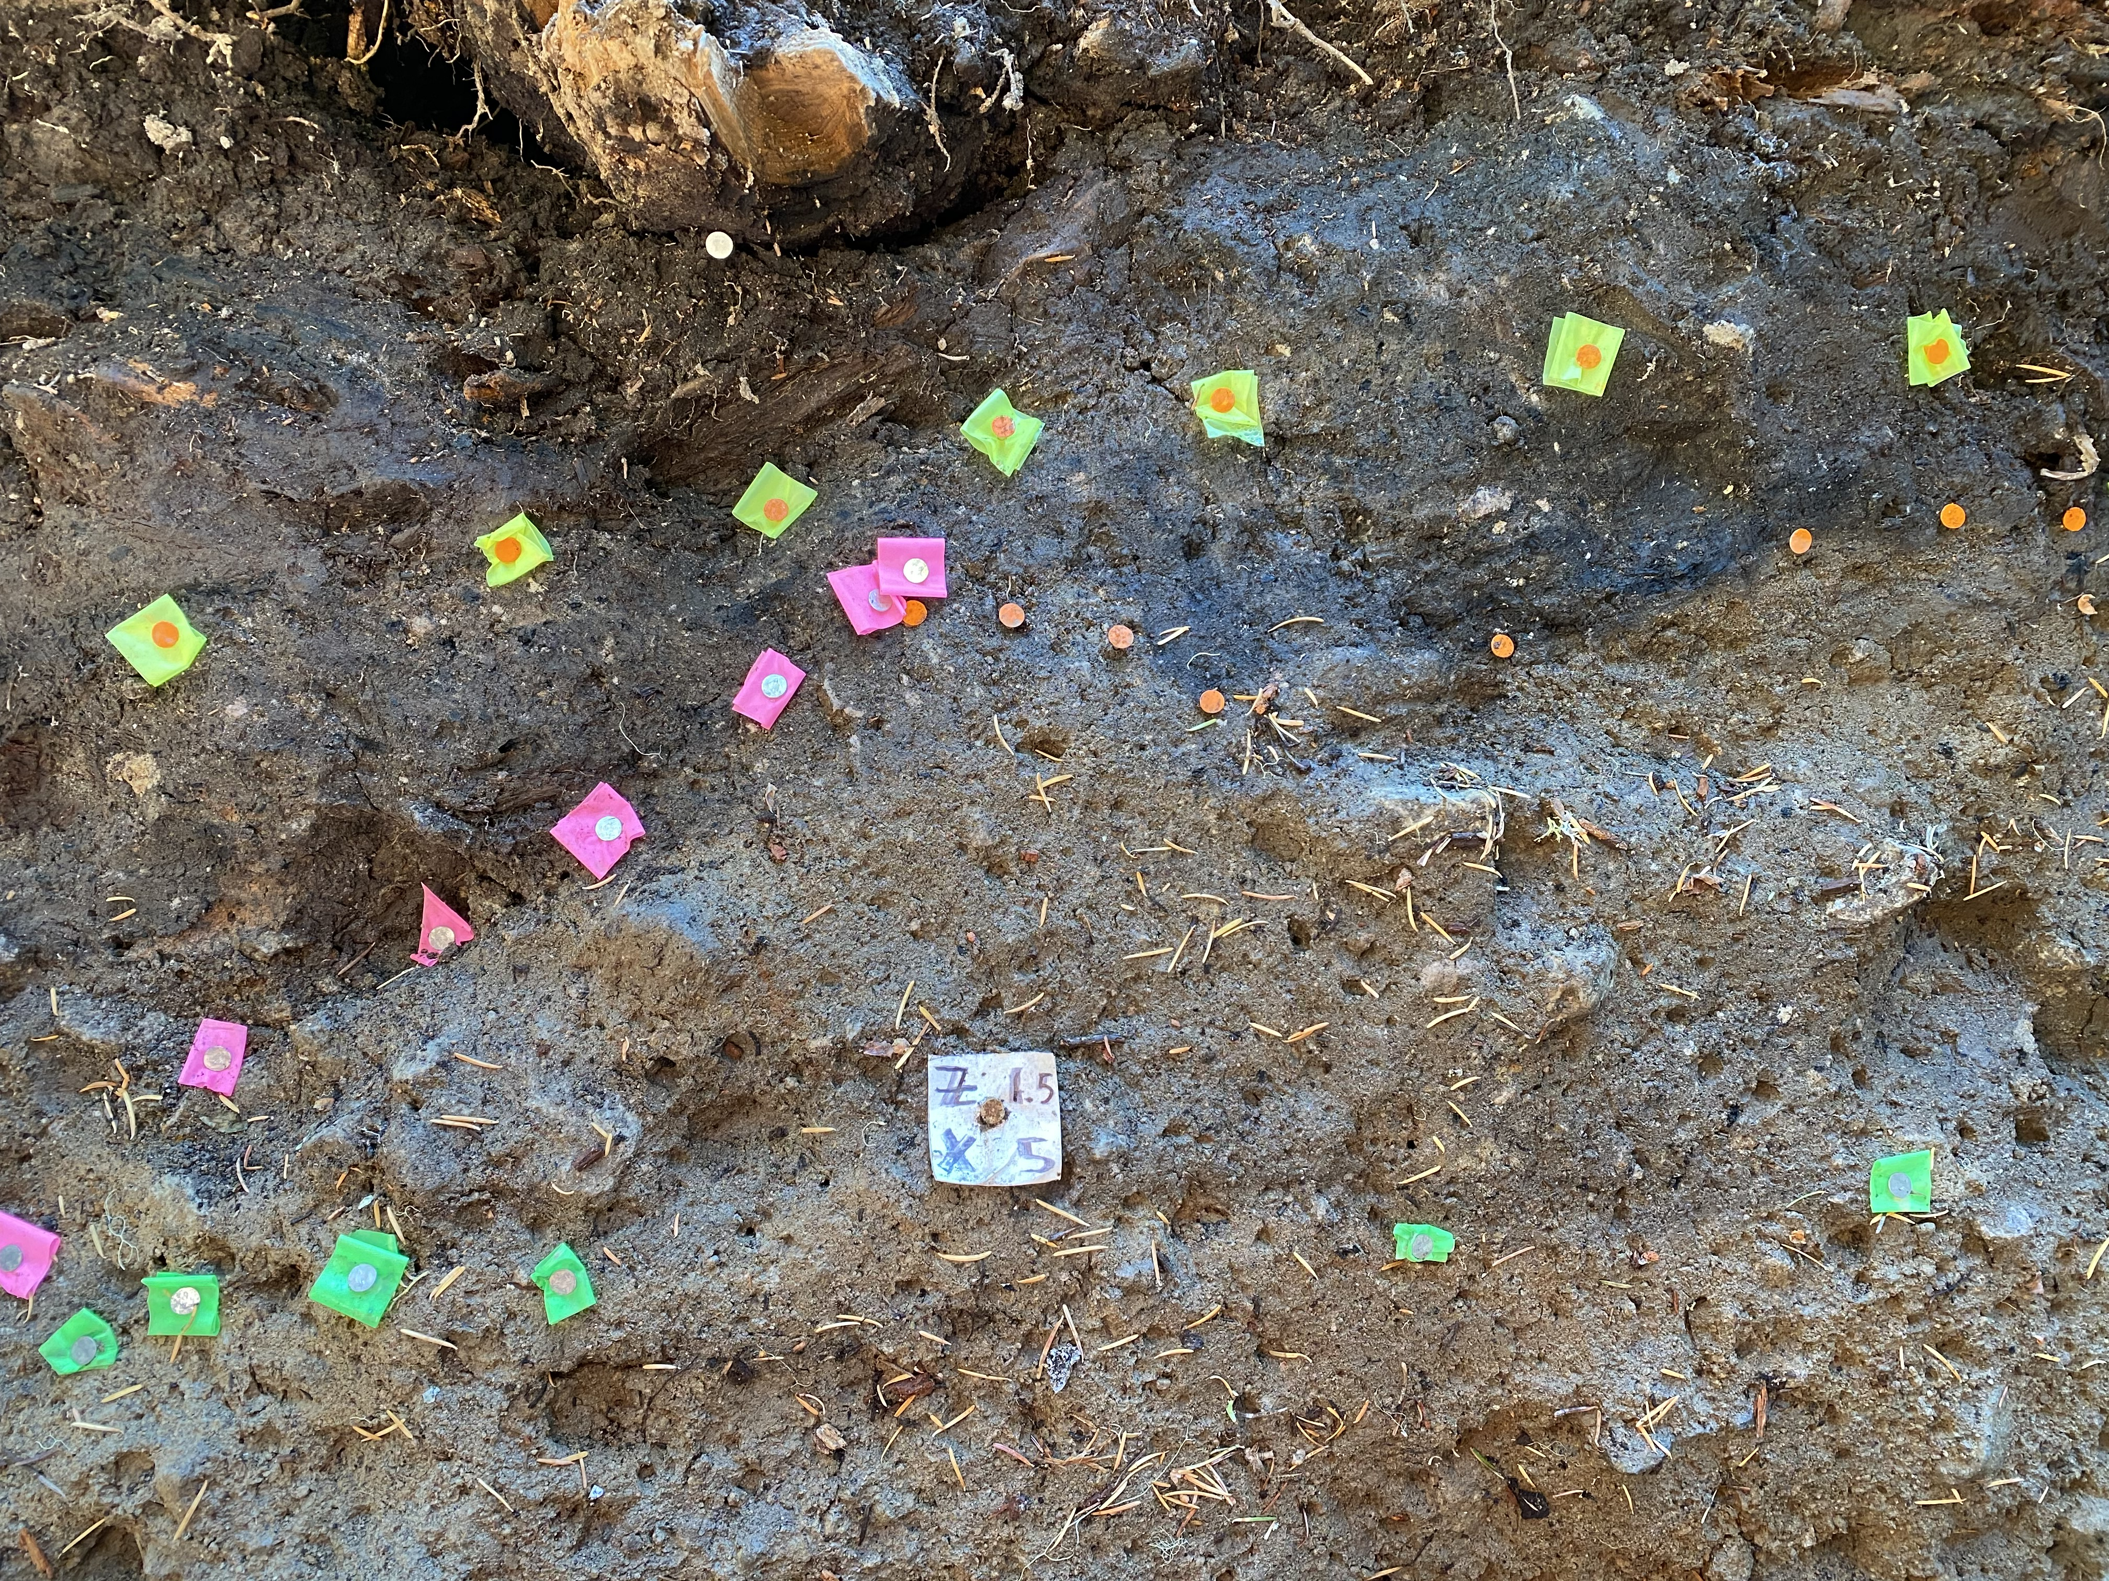
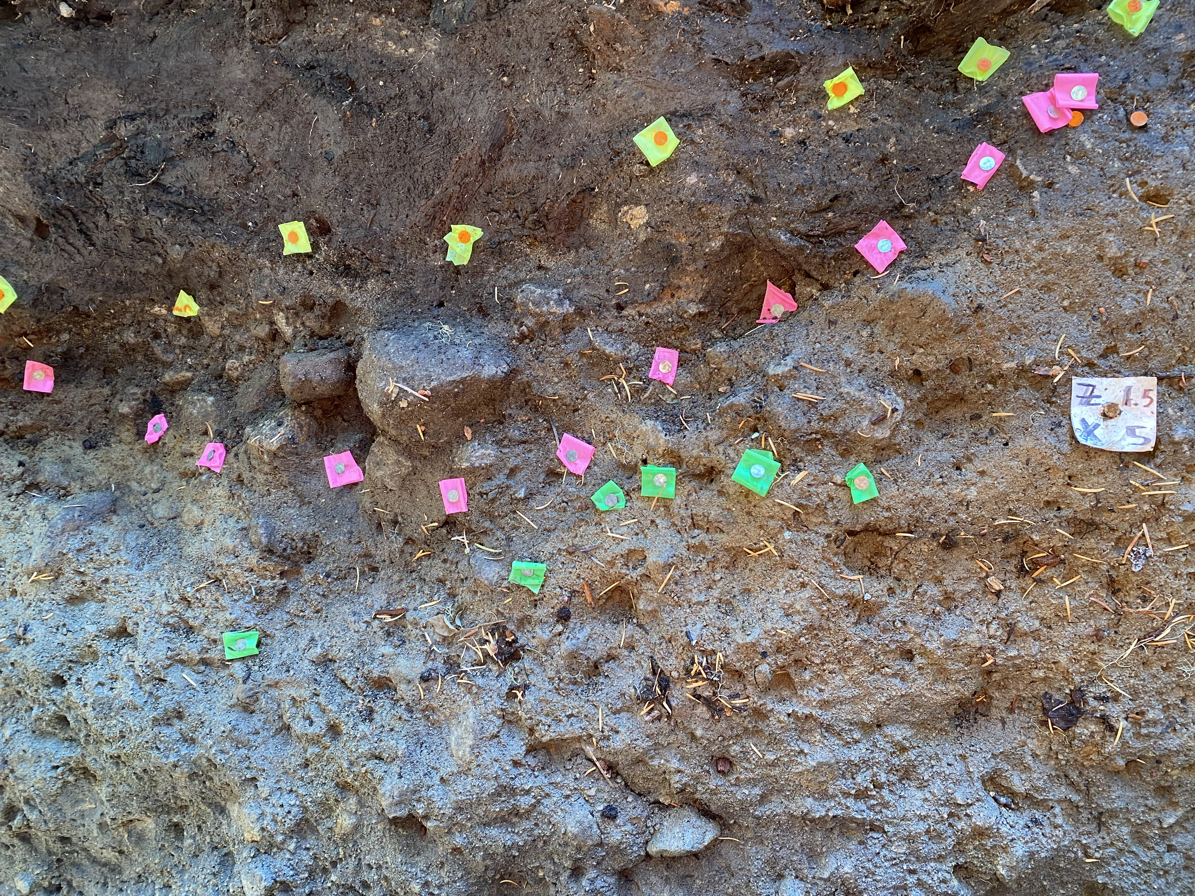
What now?
Is the Twin Lakes Fault Zone…
ACTIVE???
Notes:
Correlating stratigraphy – measuring offset (offset marsh pic)
Colors are at basal (bottom) contact
Collecting charcoal above and below faulted stratigraphy
Prep, wash, pick, $350 a sample
Is twin lakes fault zone active?
If so, how often does it rupture?
How large are the earthquakes?
Does the style of deformation in each EQ agree with normal faulting?

Slide 8
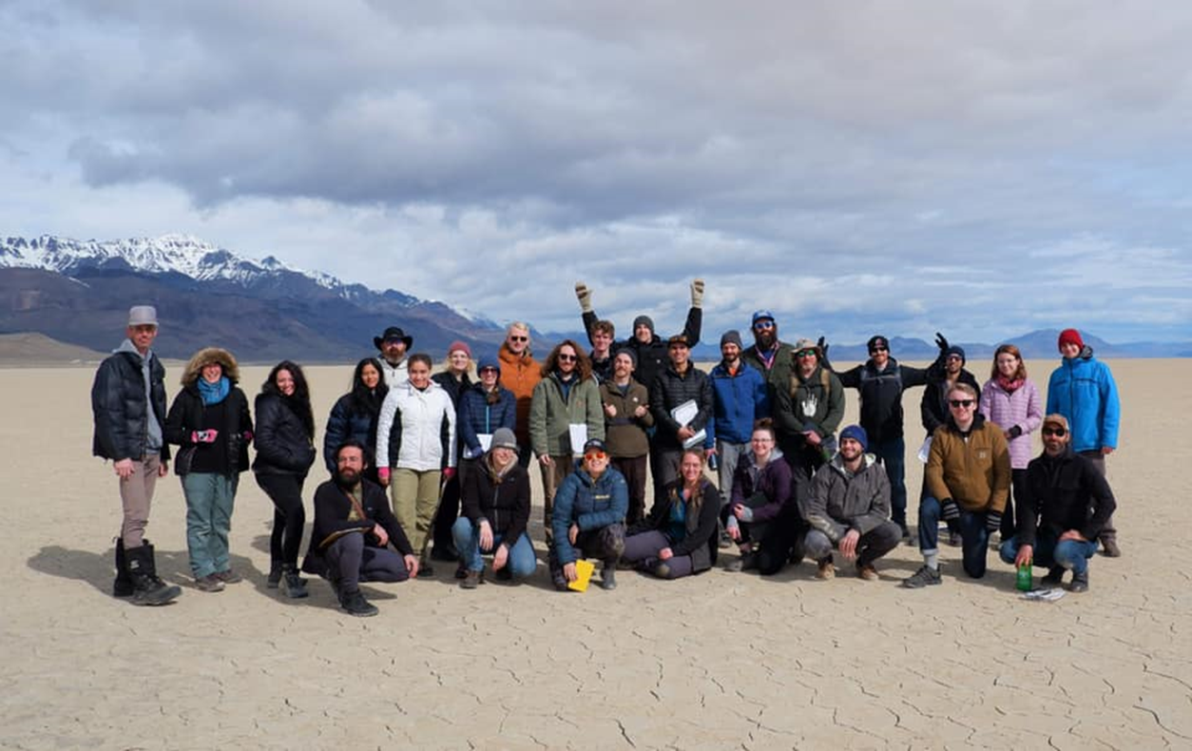
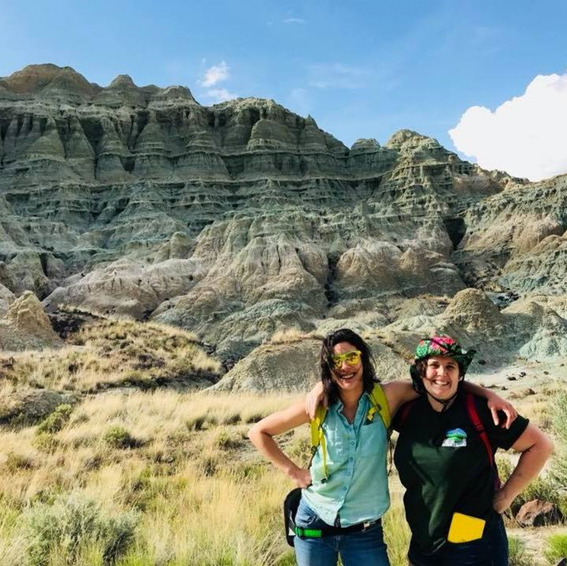
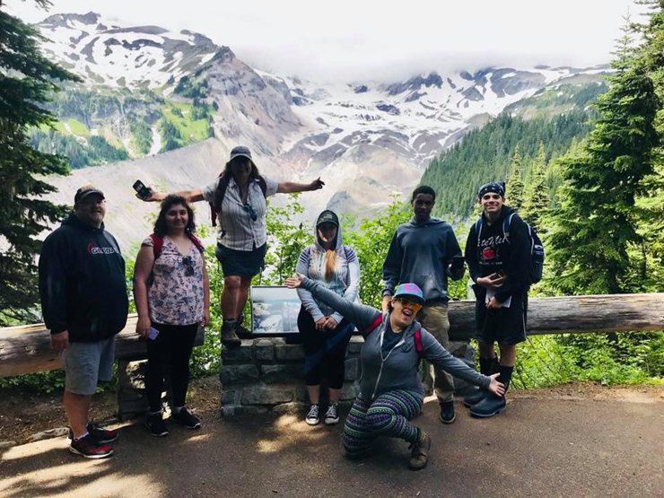
Questions?
Acknowledgements:
Dr. Ashley Streig, PSU
Ian Madden, DOGAMI
Cody Duckworth, Western Washington University
PSU McNair program
PSU Geology students and faculty
Daina Hardesty, MHCC

