Slide 1
Hell’s Tails: Localizing the tail proteins of the hyperthermophile-infecting virus SSV1
Jane Arterberry, Jono Abshier, Ken Stedman

Slide 2
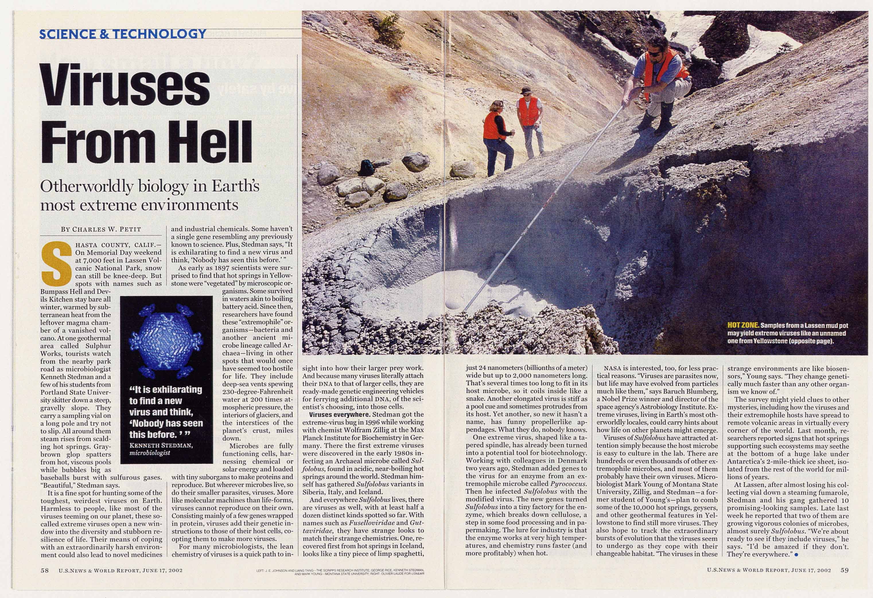
What is SSV1?

Slide 3
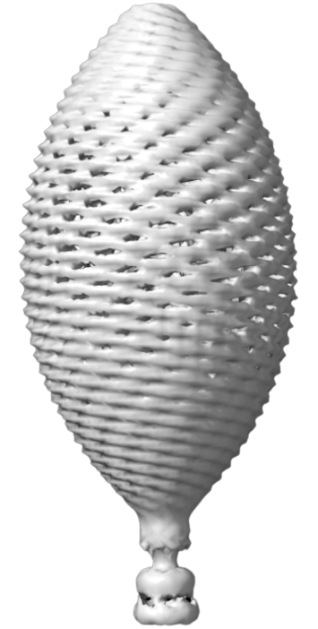
Overview
- Sacchrolobus Spindle-Shaped Virus 1 (SSV1) is an archaeal, extremophilic virus
- Proposed tail proteins: viral protein 4 (VP4), B78, and C166
- All lack cysteine residues
- Locations yet to be confirmed

Slide 4
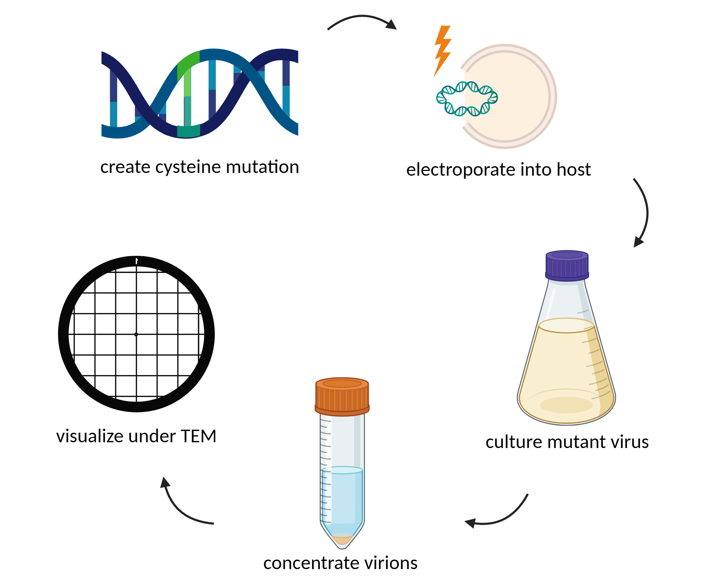
Methods

Slide 5
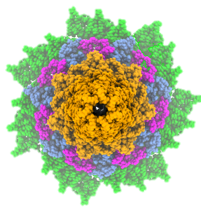
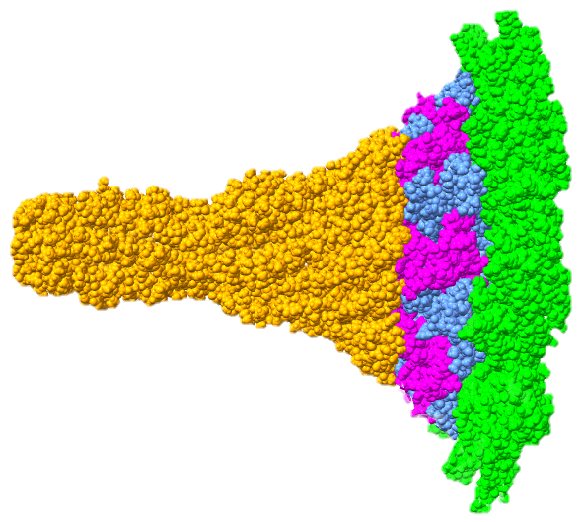
Predicted Structures
Developed and rendered using AlphaFold (Mahler and Morais, unpublished). Further processed in ChimeraX.
Fig. 2: Tail end-view
Protein Legend
 | VP1
 | VP4
 | B78
 | C166
Fig. 1: Side-view

Slide 6
Predicted Structures
Developed and rendered using AlphaFold (Mahler and Morais, unpublished). Further processed in ChimeraX.
Fig. 2: Tail end-view
Protein Legend
 | VP1
 | VP4
 | B78
 | C166
Fig. 1: Side-view

Slide 7
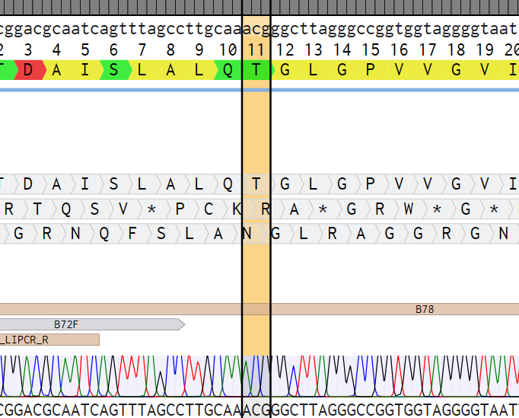
Progress
PCR showing infection of host with B78 mutant
Amplicon sequencing showing unsuccessful B78 mutagenesis
Wild-type virions under TEM with vanadium negative stain

Slide 8
Takeaways
Vanadium negative stain compatible with SSV1 imaging
AlphaFold aids in selecting mutagenesis sites
- Transforming E. coli mutant plasmids into S. solfataricus requires patience and repetition
AlphaFold renderings of B78 (L) and C166 (R) proteins with mutations highlighted

Slide 9
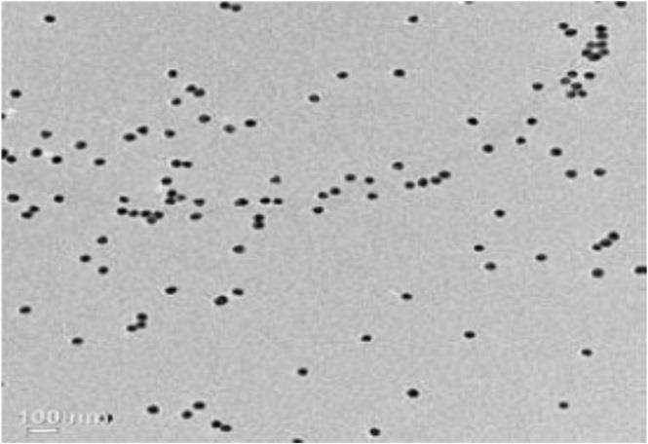
Future Directions
- Visualizing mutant virions under transmission electron microscope (TEM)
- Continuing to produce and concentrate mutant virions
100 nm
WT virions under TEM
Nanogold under TEM
(Lata et al., 2015)

Slide 10
Acknowledgements
Thank you to the eXtreme Virus Lab, especially Jono Abshier and Dr. Ken Stedman, and BUILD EXITO staff at Portland State University for their mentorship and facilitation of this research.
Thank you to Bryon Mahler and Marc Morais for their SSV1 rendering.
This work was supported by the National Institutes of Health Common Fund and Office of Scientific Workforce Diversity awards UL1GM118964, RL5GM118963, and TL4GM118965, administered by the National Institute of General Medical Sciences.
Back row (L-R): Marcell Richard, Jane Arterberry, Marisa Gonzalez, Ken Stedman, Nacho de la Higuera, Jono Abshier, David Noeckel, front row
(L-R): Luna Romero, Jenni Tran, Lou Ann O’Connor, Helena Stedman

Slide 11
Thank you!
Check out the eXtreme Virus Lab website: eXtremeViruses.org

