Slide 1
Understanding The Importance of Social Emotional Learning in Children And The Link Between Mental Health.

Slide 2
Question and Methods
If we were to bring back SEL into schools, ie.. programs like yoga, martial arts, computer games that build healthy neural pathways; then children would potentially grow into healthy adults and become more productive members of society. I am using SEL studies and comparing them to other studies in the fields of mental health treatment severe mental illness. I will be using my mentor for information on the research that he is currently conducting on children between the ages of 4 & 5, but only as an understanding of Theory of Mind (ToM). (Churchland, P.M., 1994)

Slide 3
What is Social Emotional Learning/Social Cognition?
Social Emotional Learning is technique to learn about getting along and to see outside yourself. In essence empathy is something that people are not always born with or seeing outside yourself either, e.g. Theory of Mind (ToM).

Slide 4
What is Theory of Mind?
Theory of mind is usually developed around the ages of 4 & 5 years old. The idea is that you can start to see outside yourself. This is something that people with severe mental health challenges have a hard time with.
Children usually develop this to learn coping mechanisms and to understand the world around themselves through their mind. Not to be confused as a theory but the ability to mentalize their world. (Churchland, P.M., 1994)

Slide 5
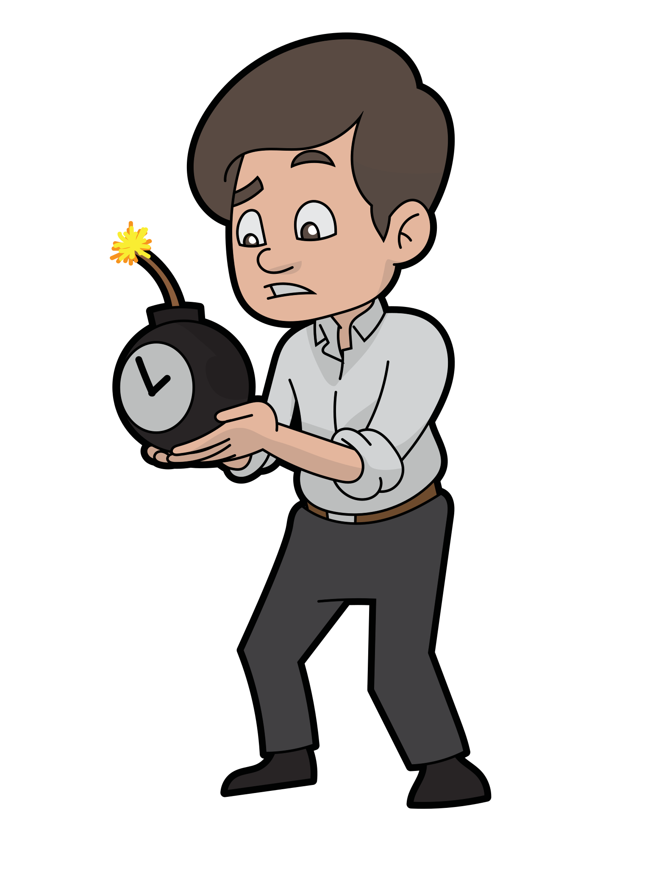
Suicide rates of children under 25 years.
This is one of the most disheartening things to hear but the rate of children under the age of 25 to comit suicide in 1964 was roughly 2.5 per 100,000. (Grove, R. G. & et al. 1950-64) The suicide rate of the same age group in 2021 was 11 per 100,000. (CDC Prevention, 2021) Why? To say that we changed the way we diagnosis is not the causausation of increased suicide rates and mental health rates, but what if it were caused by not being able to cope or not having an identity to understand outside of ones self or ToM and would changing this help?

Slide 6
The end of the beginning.
Once I complete the rest of the review I plan to add to my discoveries and implications of someone not having healthy neural pathways to form ToM or coping mechanisms and that can not create the ability to be within society. We know that as a human race we are social creatures and to not ignore that fact I think can be problematic. Our children are our future and one day they will take over. I know that I want the development of our children to be balanced and complete, making their ability to navigate life and make policy for me when I am old. To be in a better society then what I grew up in is the goal.

Slide 7
Citations
Bassok, D. & et al., (2016), “Is Kindergarten the New First Grade?” University of Virginia, Vol. 1 No. 4 pp 1-31. https://www.CASEL.org
Borman, T.H. & et al., (2018), “I3 BARR Validation Study Impact Findings: Cohorts 1 & 2.” American Institute for Research (AIR), https://www.CASEL.org
CDC Prevetion, (2021), “Disparities in Suicide.” Center for Disease Control and Prevention, https://www.cdc.gov
Churchland, P.M. (1994), “Folk Psychology (2).” In. S. Guttenplan (ed.). A Composition of the Philosophy of Mind. Oxford, Blackwell.
Corsello, M. & Sharma, A., (2015), “Building Assets Reducing Risk: BARR.” Corsello Consulting & S&S Consulting, https://www.CASEL.org
Dimond, A.D. & Lee K., (2011), “Interventions Shown to Aid Executive Function Development in Children 4 to 12 Years Old.” SCIENCE, Vol. 333, https://www.sciencemag.org
Grove, R. G. & et al, (1950-1964), “Suicide in the Unite States 1950-1964.” U.S. Department of Health, Education and Welfare, https://www.stacks.cdc.gov
Policy Studies Associates INC. (2012), “CIty Year’s Whole School Whole Child Model on Partners School’s Performance.” Policy Studies Associates, INC., https://www.CASEL.org

